Slide 1
By Nada Mostafa

Slide 2
Un doing things
▶ rm –rf .git
▶ To remove local repo
▶ Git restore new.txt
To restore from stage area (ignore changes in working tree)
▶ git commit --amend -m “your new msg”
The above command will amend
the added change to the last commit

Slide 3
Un staging changes
▶ git restore --staged new.txt
To unstage the changes
▶ git reset HEAD new.txt
To unstage the changes

Slide 4
Undoing a Commit
▶ git reset HEAD~n
To unstage the changes …keep changes in your WT but not in the index
to show differences == git diff … to restore it ===git restore .
▶ git reset –-hard HEAD~n
To restore changes into working tree direct .. Changes won’t stay in your WT
Delete the commit and the change from staging area and delete from WT
▶ git reset --soft HEAD^ ==== ~1
▶ Delete the last commit and git back to the staging area
▶ git reset --soft HEAD^^ ===== ~2
▶ Delete the last 2 commits and git back to the staging area

Slide 5
Add / Remove Remote Repo from existing project
▶ git remote add origin https://github.com/Nadamostafa2/anyrepo.git
To add a remote repository
▶ git remote -v
To list the remote repositories
▶ git remote rm origin
to remove the remote repo

Slide 6
Push / Pull Remote Repo
▶ git push origin master
To push the local changes to the remote repo
▶ git pull origin master
To get the changes that made by others

Slide 7
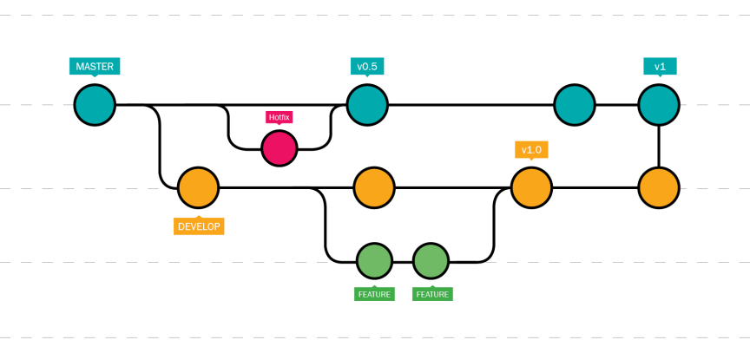
Branching

Slide 8
Branchig
▶ git branch new_branch_name
▶ To make a new branch
// switch
▶ git checkout branch_name
▶ To switch to a branch
▶ git branch
▶ To list all the branches
▶ git checkout -b new_branch_name
▶ To create a branch and checkout it in one step

Slide 9
Create a Remote Branch
When you need another people to work on your branch
▶
Then you have to make your branch available remotely
▶ git push origin branch_name
To list remote branches
▶ git branch -r

Slide 10
Remove a Branch
To delete a remote branch
▶ git push origin -d branch-name /git push origin :branch_name
To delete a local branch
▶ git branch -d branch_name
(soft delete)
▶ git branch -D branch_name
(hard delete)

Slide 11
Merging Branches
▶ After finishing your work on the branch,
▶ you’ve to merge it with the Master branch.
First, go to the Master branch
▶ git checkout master
Then, merge the two branches with each other
▶ git merge branch_name

Slide 12
Cherry-pic
▶ Git cherry-pic 40…..
▶ To merge specific commit

Slide 13
Pull Request
▶ Pull requests let you tell others about changes you've pushed to a branch in a
repository on GitHub.
▶ Once a pull request is opened, you can discuss and review the potential changes with collaborators and add follow-up commits before your changes are merged into the base branch.

Slide 14
Tagging & Versioning
A tag is a reference to a commit - used mostly in release versioning.
▶ Git supports two types of tags:
Lightweight
Annotated.

Slide 15
Tags Types
▶ git tag v1.0
▶ To create a lightweight tag
▶ git tag -a v2.0 -m “version 2.0”
▶ To create an annotated tag

Slide 16
Push Tags
To list all tags
▶ git tag
To push tags
▶ git push origin <tag_name>
▶ git push --tags

Slide 17
Delete Tags
To delete remote tag
▶ git push origin --delete v1.0
To delete local tags
▶ git tag -d v1.0

Slide 18

Ignoring Files

Slide 19
Ignoring Files
Often, you will have a class of files that you don’t want git to automatically add or even show to you as being untracked.
In such cases you can create a file called .gitignore to contains all the
unwanted files or directories.
cache/
logs/*.log

Slide 20
forking

Slide 21

Lab 2
Create a new project on your local machine,
then push it your remote repo.
Create two branches (dev & test) then create one
file on each branch, and push this branches to the remote repo.
Merge this changes on Main branch locally and then push it to your
remote main branch.
Create an annotated tag with tagname (v1.7)
Push it to the remote repository
Send an invitation to me “nadamosatafa44127@gmail.com

